Slide 1


SALES REPORT
1

Slide 2
Problem Statement
Sales teams often lack a clear, data-driven understanding of regional performance, making it difficult to identify growth opportunities and optimize resources. This project aims to analyse and visualize regional sales data to uncover trends, evaluate profitability, and support strategic decision-making.
What’s the Business Question?
Inconsistent revenue and profit performance across U.S. regions Lack of visibility into seasonal swings, top SKUs, and channel profitability Goal: Leverage 5 years of historical data to pinpoint growth levers and optimize strategy

Slide 3


Charts & Insights

Slide 4
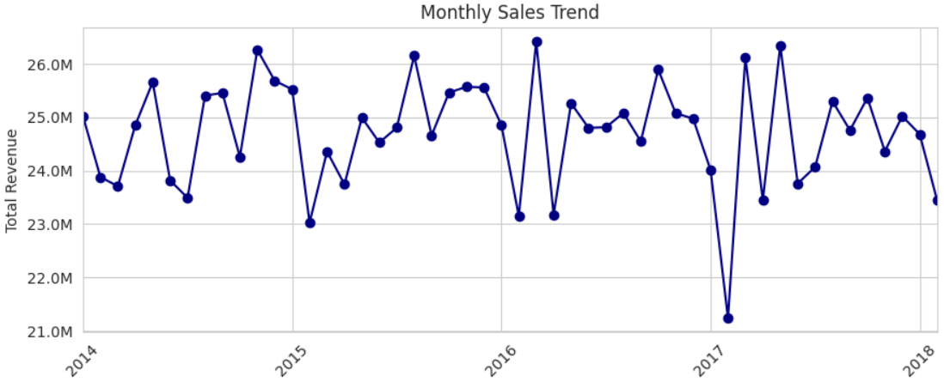

Monthly Sales Trend Over Time
Insights
Consistent sales cycle: $24M to $26M.
Seasonal peaks: Late spring/early summer (May-June).
Annual low: January.
Notable outlier: Sharp revenue drop in early 2017.

Slide 5
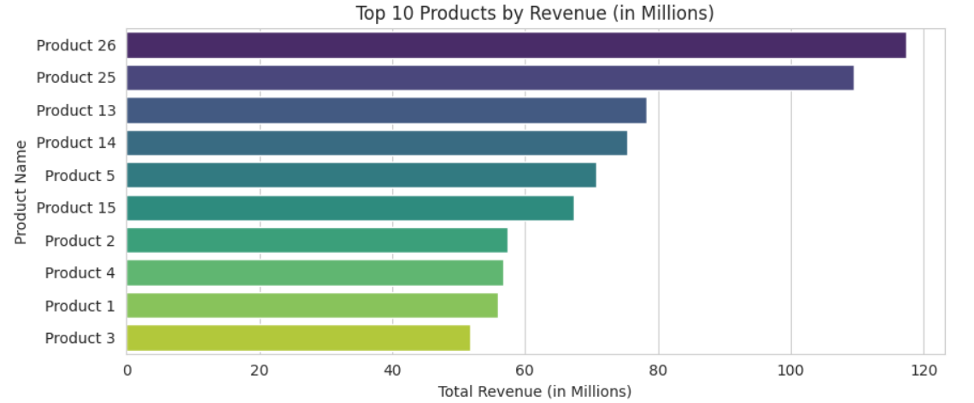
Top 10 Products by Revenue
Insights
Revenue leaders: Products 26 & 25 dominate.
Mid-range: Products 5, 13, 14, 15 show similar revenue.
Bottom cluster: Products 1, 2, 3, 4 have the lowest revenue.
Strategy: Grow mid-tier, improve lower performers.

Slide 6
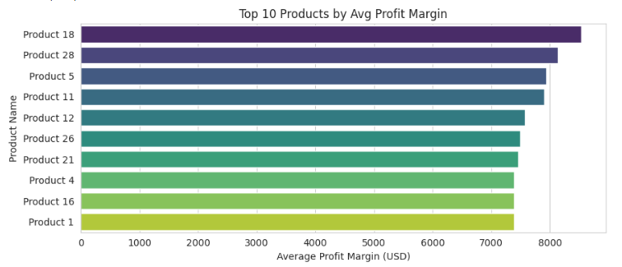
Top 10 Products by Average Profit Margin
Insights
Top: Products 18 & 28 lead at ~$8.1–8.4K.
Next tier: Products 5, 11, 12 & 26 at ~$7.5–7.8K.
Entry‑level: Products 1, 4, 16 & 21 around $7.3K.
Takeaway: Top 10 all exceed $7.3K—consistent high margins.

Slide 7
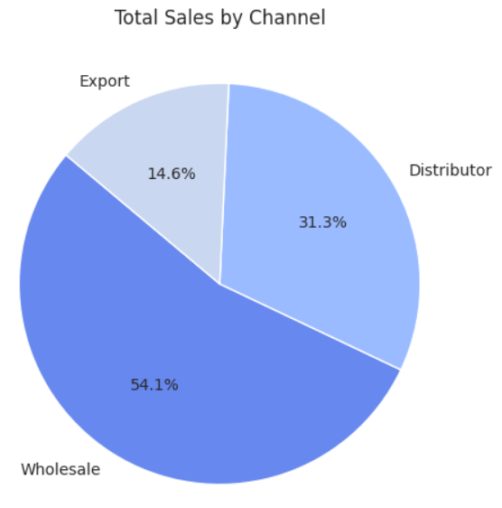
Sales by Channel
Insights
Wholesale dominates: Generates the majority of total sales at 54.1%.
Distributor is significant: Contributes a substantial 31.3% to total sales.
Export is a smaller portion: Accounts for 14.6% of the total sales.

Slide 8
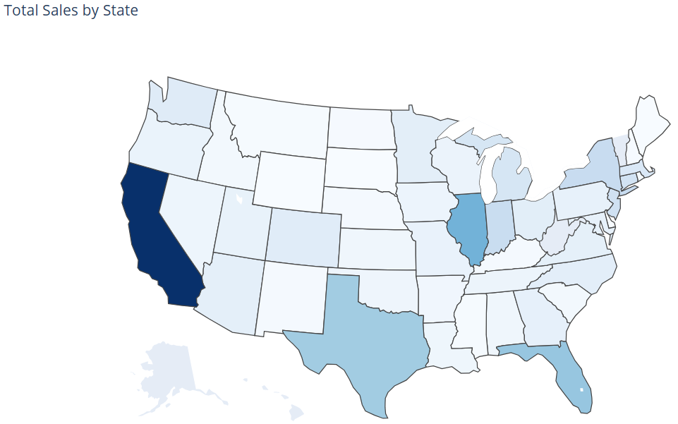
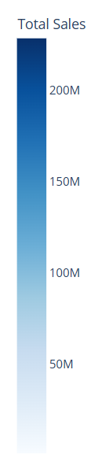
Total Sales by State (Choropleth Map)
Insights
California leads: Highest total sales.
Texas, Florida, Illinois: Significant sales.
Varying sales: Other states show moderate to low sales.
Visual pattern: Higher sales in larger and some coastal states.

Slide 9
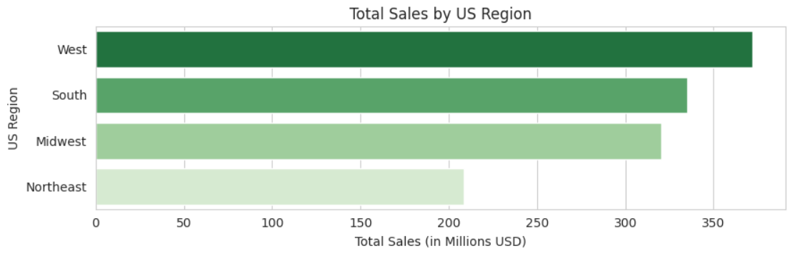
Total Sales by US Region
Insights
West: Highest sales, strong market influence.
South: Major sales contributor, key market area.
Midwest: Steady sales performance, moderate market size.
Northeast: Lowest sales, suggests need for deeper market understanding.

Slide 10
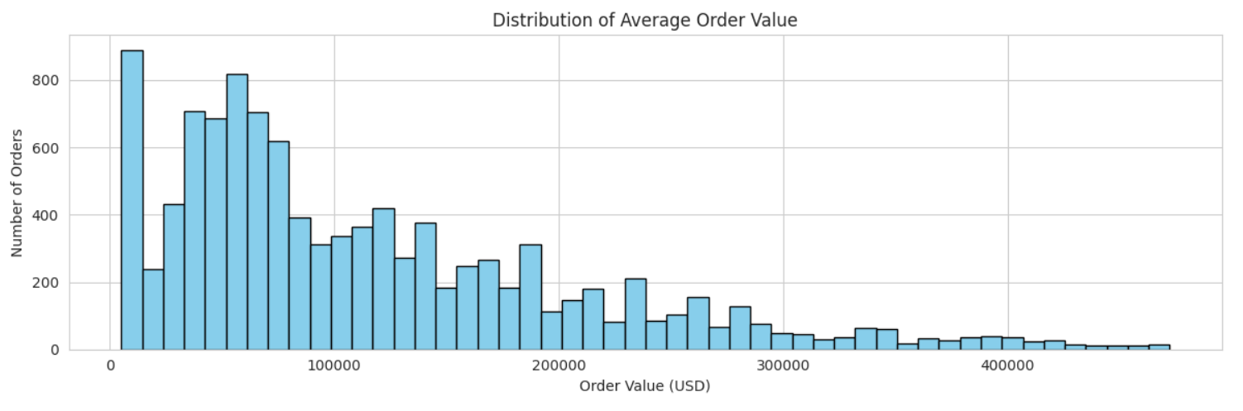
Average Order Value (AOV) Distribution
Insights
Low average order values are frequent.
Distribution is right-skewed (long tail of high-value orders).
Multiple order value clusters exist.
Higher order values are less common.

Slide 11
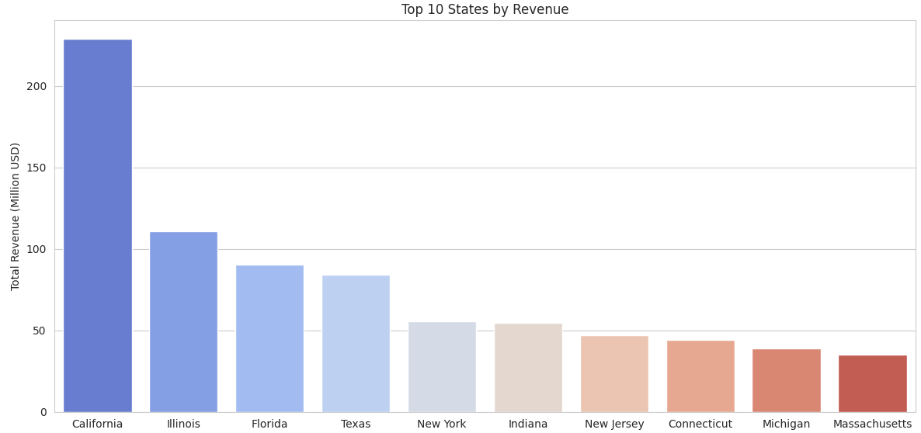
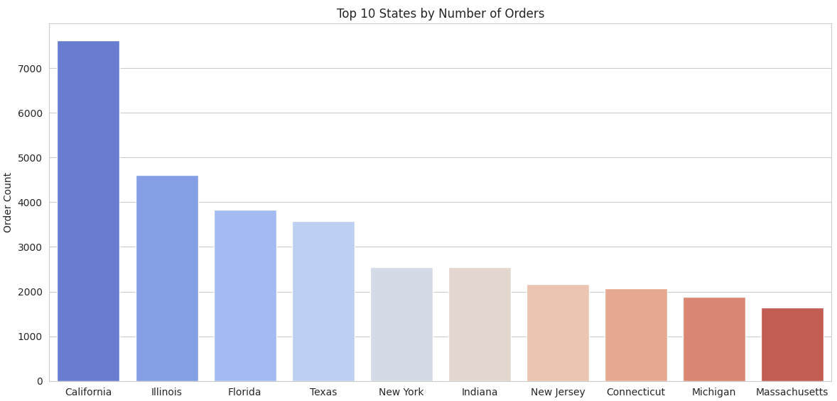
Top State Performance: Revenue vs. Orders
Insights
California tops revenue & orders.
IL, FL, TX: High in both.
Revenue & orders linked.
Other top states: Lower contribution.

Slide 12
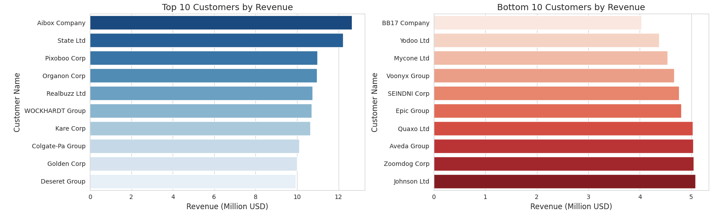
Top and Bottom 10 Customers by Revenue
Insights
Aibox Company leads significantly as the top revenue generator.
Bottom 10 customers generate substantially less revenue (around $4-5M).
Revenue concentration: Top customers drive a disproportionate share.
Large gap: Exists between the revenue of top and bottom tier customers.

Slide 13
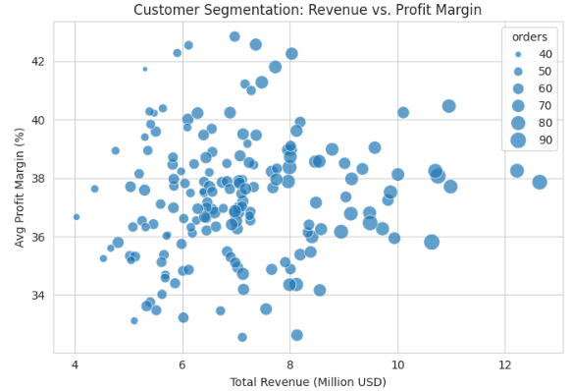
Customer Segmentation: Revenue vs. Profit Margin
Insights
Those Uniform 35–40 % margins confirm strong, consistent pricing and cost control.
>$10 M clients with <36 % margins reveal discounting hotspots—re evaluate large‑account terms.
$6–9 M clients with >40 % margins are high‑value candidates for targeted upsell.

Slide 14
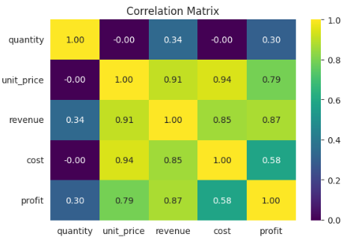
Correlation Heatmap of Numeric Features
Insights
Unit price is the primary driver, showing very strong correlations with cost (0.94), revenue (0.91) and profit (0.79).
Revenue & profit maintain a high link (0.87), underscoring direct profitability gains.
Quantity’s impact is minimal (≤ 0.34 vs. financials), indicating volume plays a secondary role.
Cost vs. profit correlation (0.58) is moderate, suggesting margin improvement focus should center on pricing.

Slide 15
Key Insights

Slide 16


Key Insights
Pronounced Seasonality: January revenues average $124 M, dipping to $95 M in April. SKU Concentration: Products 26 & 25 together drive ~25 % of total sales. Channel Trade‑Off: Wholesale captures 54 % of volume; Export leads with ~38 % average margin. Geographic Dominance: California alone logs 7.6K orders ($230 M); the West region shows the largest swings. Aibox Company and State Ltd are the most valuable customers in terms of Revenue.

Slide 17
Dashboard Preview

Slide 18
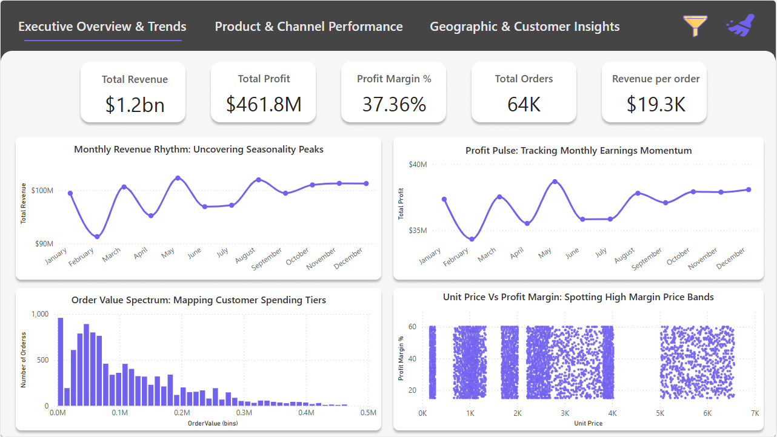
Page 1 - Performance Summary

Slide 19
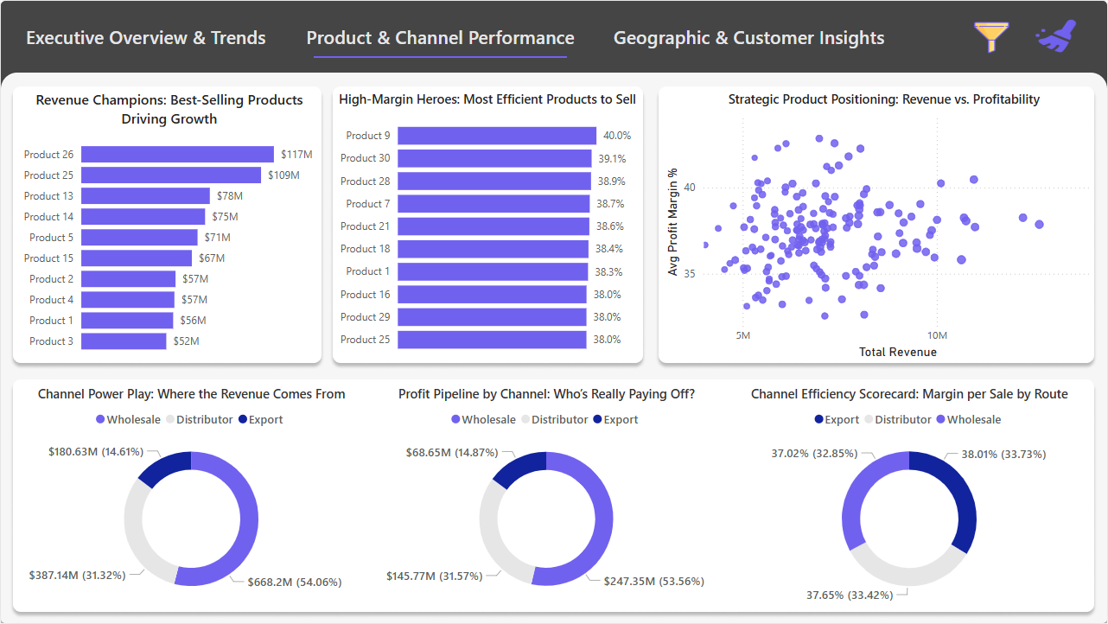
Page 2 - Customer Segmentation

Slide 20
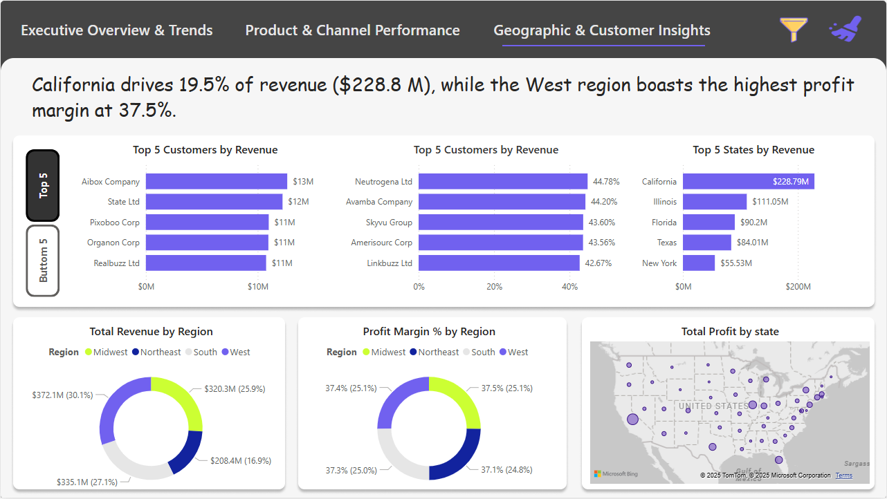
Page 3 - Revenue Scenarios

Slide 21
Conclusion

Slide 22

Conclusions
Completed end‑to‑end EDA and interactive Power BI dashboard, surfacing seasonality, SKU, channel & regional insights. Insights inform sales policies and operational planning (store & warehouse prep aligned with annual trends). Stakeholders can self‑serve real‑time analysis and confidently onboard new datasets for additional use cases.

